Slide 1


Parent Teacher Student Association (Ptsa)
Gwynn park high School (GPHS)
GENERAL Membership meeting
Tuesday, November 4, 2025

Slide 2

Mission
Every Child. One Voice.
PTA’s mission is to make every child’s potential a reality by engaging and empowering families and communities to advocate for all children.

Slide 3
Our VALUES
Collaboration: We will work in partnership with a wide array of individuals and organizations to broaden and enhance our ability to serve and advocate for all children and families.
Commitment: We are dedicated to children’s educational success, health, and well-being through strong family and community engagement, while remaining accountable to the principles upon which our association was founded.
Diversity: We acknowledge the potential of everyone without regard, including but not limited to age, culture, economic status, educational background, ethnicity, gender, geographic location, legal status, marital status, mental ability, national origin, organizational position, parental status, physical ability, political philosophy, race, religion, sexual orientation, and work experience.
Respect: We value the individual contributions of members, employees, volunteers, and partners as we work collaboratively to achieve our association’s goals.
Accountability: All members, employees, volunteers, and partners have a shared responsibility to align their efforts toward the achievement of our association’s strategic initiatives.

Slide 4

Welcome
Mission Statement
Roll Call
Approval of Agenda
Approval of Minutes – Oct 7, 2025
President’s Report - PTSA GPHS Overview
Financial Report
Principal Report
Committee Reports
  Call for Volunteers
Concerns / Questions
Adjourn

Slide 5


Slide 6
President’s report
PTSA Overview
Our Accomplishments
  Featured Speakers/Topics throughout General Meetings
  Sponsored Staff/School Events & Meals
  Beautification Projects
  Book Scholarships (2)
  PTSA GPHS Honors Recognition Award of Staff
Governance
Operating Procedures
Transition Plan 2026

Slide 7

Reports
- Financial
- Principal
- Committees

Slide 8
PTSA
GPHS
STANDING COMMITTEES

Slide 9
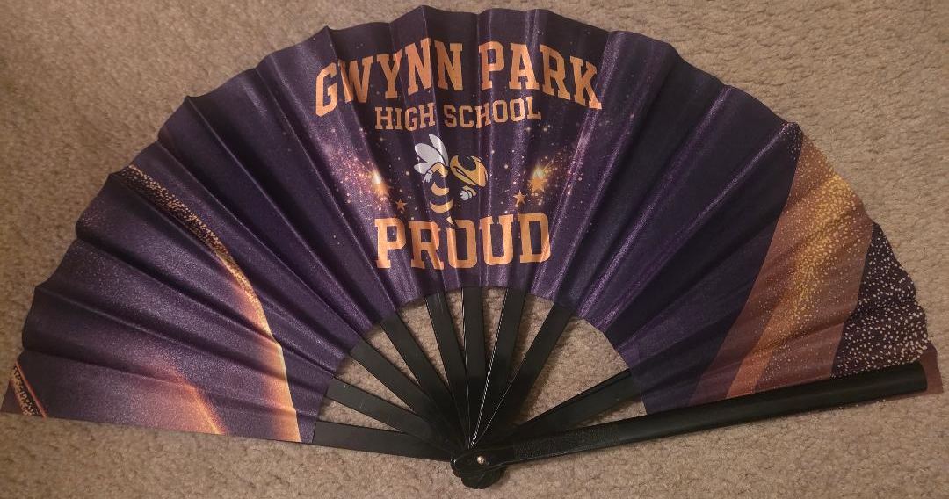



Fundraising
Spring/Fall Events
GPHS Fans - $20
PayPal: PTSA Gwynn Park High School

Slide 10




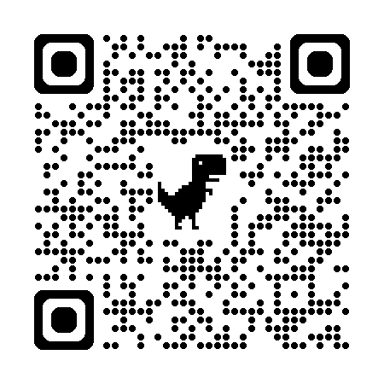
Membership drive
https://ptsagwynnparkhs.givebacks.com/shop

Slide 11


CALL FOR VOLUNTEERS

Slide 12

Open discussion
& Questions

Slide 13
meeting adjourned
Next Meetings:
  Board of Directors Meeting (Tuesday, November 26, 2025)
  General Membership Meeting (Tuesday, January 6, 2026)

