Slide 1


Parent Teacher Student Association (Ptsa)
Gwynn park high School (GPHS)
OVERVIEW

Slide 2

Mission
Every Child. One Voice.
PTA’s mission is to make every child’s potential a reality by engaging and empowering families and communities to advocate for all children.

Slide 3
Our VALUES
Collaboration: We will work in partnership with a wide array of individuals and organizations to broaden and enhance our ability to serve and advocate for all children and families.
Commitment: We are dedicated to children’s educational success, health, and well-being through strong family and community engagement, while remaining accountable to the principles upon which our association was founded.
Diversity: We acknowledge the potential of everyone without regard, including but not limited to age, culture, economic status, educational background, ethnicity, gender, geographic location, legal status, marital status, mental ability, national origin, organizational position, parental status, physical ability, political philosophy, race, religion, sexual orientation, and work experience.
Respect: We value the individual contributions of members, employees, volunteers, and partners as we work collaboratively to achieve our association’s goals.
Accountability: All members, employees, volunteers, and partners have a shared responsibility to align their efforts toward the achievement of our association’s strategic initiatives.

Slide 4
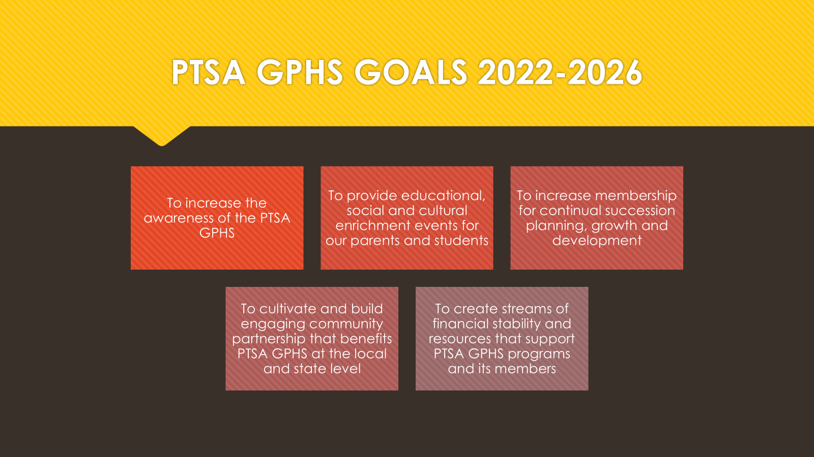

Slide 5
PTSA GPHS
STANDING COMMITTEES
FUNDRAISING
Responsible for generating ideas / events to raise money
Coordinate logistics and needs for fundraiser that follow PTSA
Evaluates the fundraiser at the end regarding the impact to the PTSA
MEMBERSHIP
Responsible for PTSA GPHS membership drives and campaigns
Maintains records of all members
Provides membership roster for the Secretary’s permanent file
Collects and accounts for all dues and provides to the Treasurer for deposit in timely manner
Maintains and issues membership cards
Helps coordinator décor and food for PTSA events when necessary

Slide 6
Standing Committees Cont.
PARENT / FAMILY ENRICHMENT
Provides engaging and educational information to parents / families
Develops workshops on topics that impact and empower parents / families’ knowledge and social and cultural awareness
Provides resources and activities that benefit the PTSA general body and GPHS community
COMMUNITY RELATIONS / PARTNERSHIP ADVOCACY
Cultivates partnership with businesses and community partners for the PTSA GPHS
Establish local and community relationships that promote the PTSA GPHS mission/goals/body
Responsible for being the liaison for PTSA GPHS on local and state issues and recommends courses of actions for PTSA GPHS
Attends legislative meetings to inform the PTSA GPHS on actions impacting our school / family

Slide 7
Standing Committees Cont.
PUBLICITY / COMMUNICATION
Solicits information and photographs pertaining to PTSA GPHS
Updates PTSA GPHS website and information on social media platforms
Prepares flyers and other communications regarding PTSA GPHS events
Communicates to the general body on upcoming events and community news.
BEAUTIFICATION
Seeks ideas and plans to beautify the Gwynn Park building and environment (internal /external)
Cultivates a welcoming atmosphere for students, staff, parents, and guests

Slide 8
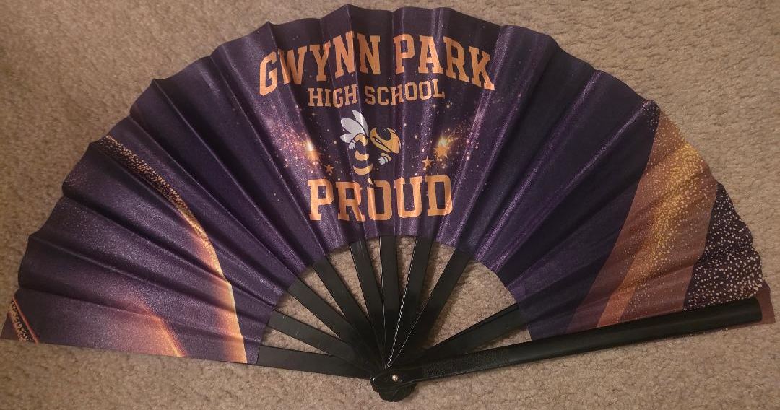



Fundraising
Spring/Fall Events
GPHS Fans - $20
PayPal: PTSA Gwynn Park High School

Slide 9


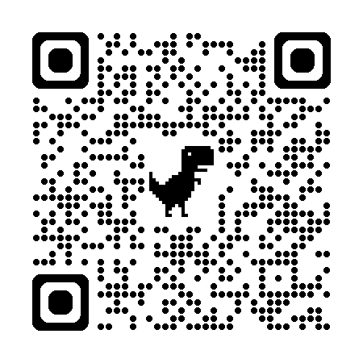
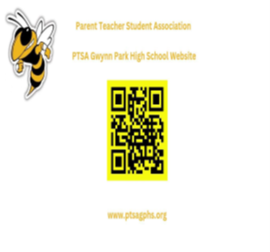
Membership – WE NEED YOU!!
https://ptsagwynnparkhs.givebacks.com/shop

